Slide 1
Embedding Developmentally Appropriate Practice Across Elementary Education Coursework
Dr. Teri Peasley
Dr. Jen Lisy
OCTEO 2023

Slide 2
https://tinyurl.com/octeodap23
Notes:
PPT presentation
Crosswalk
NAEYC's DAP resources for faculty
Link to NAEYC DAP webpage

Slide 3
Session Outcomes
By the end of this presentation, participants will be able to:
Align chapters of Developmentally Appropriate Practice in Early Childhood Programs with courses in an early childhood or elementary education program.
Embed DAP into specific courses to better prepare future educators for their teaching careers.
Describe the benefits of integrating DAP across the curriculum.

Slide 4
Notes:
Jen intro – this was Teri’s vision
Cornerstone for all early childhood education
Fully researched and vetted
Jumping into the middle of the swimming pool
All of our textbooks start with a little of the foundation
Missing the basement
With the caveat that it is white and Eurocentric bc we are missing research about marginalized communities
https://www.naeyc.org/resources/position-statements/dap/core-considerations

Slide 5
Analyzed the text to associate content with courses across the program sequence
Reviewed NAEYC Resources
Faculty
Webinars
Materials
Created a crosswalk with our courses and DAP

Slide 6
DAP Content | Aligned course
NAEYC Position Statement | ECEE 2001: Sophomore Clinical Practice ECEE 2301: Integrated Curriculum
Chapter 1: Intentional Teaching: Complex Decision Making and the Core Considerations | ECEE 2301: Integrated Curriculum
Chapter 2: The Principles in Practice – Understanding Child Development and Learning in Context | All program courses Will be introduced in ECEE 2301
Chapter 3: Context Matters – Reframing Teaching in Early Childhood Education | EDTE 1000: Introduction to Teaching EDEC 1600: Introduction to Child Development
Notes:
Snapshot of our crosswalk showing how the DAP text was aligned to our courses.

Slide 7
Across all 4 years of coursework
Intentional in-class activities, explorations, and discussions for specific courses
Embedded discussions in courses when content had been previously introduced

Slide 8
Used the DAP book in various ways
Individual reflection
Field experience observation
Interactive learning experiences

Slide 9
ECEE 2301: Integrated Curriculum in Early Childhood Education (Sophomore fall semester)
Unpacking the Position Statement:
Core Considerations – commonality, individuality, context
Guidelines for DAP in practice
Principles of DAP

Slide 10
ECEE 2301: Integrated Curriculum in Early Childhood Education (Sophomore fall semester)
Diving into DAP:
Chapter 1 – Intentional Teaching: Complex Decision Making and Core Considerations
Chapter 2 - The Principles in Practice: Understanding Child Development and Learning in Context
Chapter 3 – Context Matters: Reframing Teaching in Early Childhood Education
Chapter 4 – Teaching Content in Early Childhood Education

Slide 11
Pre/Post Snapshot

Slide 13
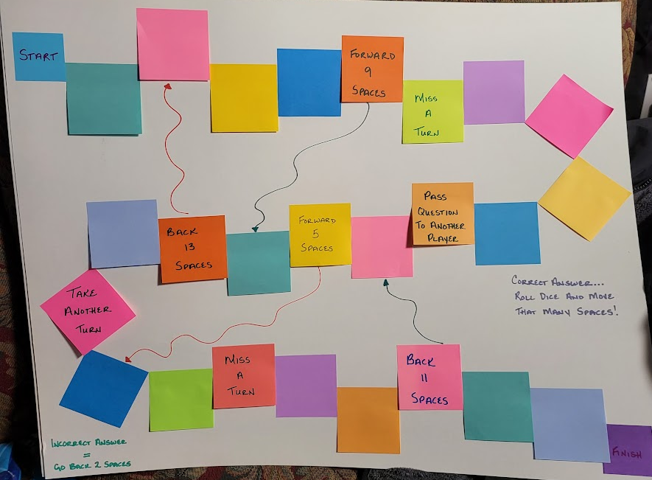
High-quality instruction includes a balance of _____ play and _____ learning experiences.
(self-directed and teacher guided)
Teachers must be aware of their own _____ and how they impact their interactions with students and families.
(biases)
Identify five developmentally appropriate ways in which writing skills can be practiced in a preschool setting.
(Whole group must decide if your response is accurate and complete)

Slide 14
ECEE 4500: Principles and Practice of Curriculum in Early Childhood and Elementary Education (Senior fall semester)
Online Capstone Course for Early Childhood and Elementary Education Majors
Revisit DAP
Chapter 4: Teaching Content in Early Childhood Education
Chapter 10: Planning and Implementing an Engaging Curriculum to Achieve Meaningful Goals

Slide 15
Guided Discussion DAP Ch. 10
What will culturally and linguistically responsive curriculum look like in your classroom?
What are examples and non-examples you have seen in your placements?
Choose one concept to discuss with your group.
Why is this essential to creating a DAP classroom?

Slide 17
Students became competent in:
Aligning lesson plans and teaching activities with the Principles of DAP
Using the language of developmentally appropriate practice across their classes.
Clearly articulating their instructional choices regarding developmental appropriateness.
Questioning practices they observe in the field or in videos of classroom instruction that do not seem to align with DAP

Slide 18
Discussion
Review the DAP Crosswalk
Where could you embed it in your courses?
How would it impact your students?
What questions to you have about implementation?

Slide 19
Links to Resources
NAEYC Faculty Resources - https://www.naeyc.org/resources/developmentally-appropriate-practice/get-faculty-resources
Developmentally Appropriate Practices Position Statement - https://www.naeyc.org/resources/position-statements/dap/contents
Link to Crosswalk – https://catmailohio-my.sharepoint.com/:w:/g/personal/lisy_ohio_edu/ETPBn6DXUcdGqAkMtMRdFuUBazOXH12uSkrNbbXqpihZ6w?e=jMbDml
Link to Developmentally Appropriate Practice Means… Pre/Post Snapshot - https://catmailohio-my.sharepoint.com/:w:/g/personal/lisy_ohio_edu/EQ8NK_124RpIhkg4xOHtVZ4BnVcipFM52dDZ4CkDCM2n1A?e=nUh5xT

